Slide 1
Optical Infrared Coordination Network for Astronomy
(FP7 2013 – 2016), HORIZON (2017-2020)
brings together all the national and international agencies and organisations, which fund, support, develop and operate Europe’s facilities for optical and infrared night-time astronomy.
provides a framework allowing joint actions to improve the quality of Europe’s infrastructures, to train new astronomers, especially those from Central Europe, in modern new research methods,
to develop innovative technologies to enhance research quality.
to provide access to mid-size optical telescopes: 2 calls per year-February and August

Slide 2
TIME ALLOCATION COMMITTEE
Member information
Frank Grundahl, Aarhus University, Denmark
Beth Biller, Institute for Astronomy, ROE Edinburgh
Guilaine Lagache, Laboratoire d'Astrophysique de Marseille, Aix-Marseille Université, France
René Duffard, Instituto de Astrofísica de Andalucía, Spain
Ennio Poretti, Osservatorio Astronomica di Brera, Italy [Chair]
Geza Kovacs, Konkoly Observatory, Hungary
Jochen Heidt, LSW, Heidelberg, Germany

Slide 3
The group leader and the majority of the users must work at institutions which are outside the country/ies which operate the telescope'. The interpretation of 'majority' is 50% + 1 user, and the user group leader is a member of the user group.
Note that projects led by, or dominated by, non-EU persons are no longer prohibited but such projects are limited to 20% of the total allocations. In practice this means only a small number of such projects can be allocated and so such proposals must be exceptionally well justified. If in doubt, contact the OPTICON Project Scientist (details below) for clarification.

Slide 4
OBSERVATIONS
Monitoring: Observations which require a regular cadence (eg SN decay, giant planet weather, comet activity with heliocentric distance) but which are not highly date/time specific. May be executed in ‘service mode’ to minimize PI travel.
Service Mode: Observations which are carried out by a local astronomer as part of a classically scheduled operations without flexibility for specific observing constraints. Also known as ‘Delegated visitor mode’. The PI is not expected to provide an observer.
Robotic: Automated telescope or network of telescopes using software to schedule and execute observations according to observatory schedule, weather and priority algorithms without direct human intervention on a nightly basis. Essentially automated queue scheduling without real-time human discretion.
Requests for multiple telescopes for the same scientific project must be included in a single proposal form.

Slide 5
Successful proposers will receive travel funds as necessary for them to take up the observing time. This will normally be for a single observer. If travel support for more than one observer is required for clearly demonstrated scientific reasons it will be necessary to get confirmation from the Project Scientist (details below). Please also see the section on Trans-National Access on our Rules for Travel page.
The proposal software, an OPTICON variant of the NORTHSTAR system already in use at several observatories, is available at the following url: http://proposal.astro-opticon.org. You are required to register for account (only minimal information is required) and you can then create, share and complete your proposal on-line.

Slide 6
Isaac Newton Group of Telescopes, La Palma,
Roques de los Muchachos Observatory:
4.2 m William Gershel Telescope ; Monitoring mode – yes
ISIS: 3000-10000Å; 600<R<12700; 0.2”/px; 1.62 Å/px; slit – 4′; + imaging polarimetry and spectropolarimetry
LIRIS: 9000-24000Å; 1000<R<3000 slit – 4′ + imaging polarimetry and spectropolarimetry
ACAM: 3500 - 9400 Å R ~ 400 slit – 6′
AF2/WYFFOS: 3500 - 10000 Å 100 < R < 3000 (reflection mode) R = 9500 (echelle mode)
IMAGING MODE
ACAM: FOV is 8 arcmin (0.25 arcsec/pixel). A set of broad-band filters is available by default (SDSS u g r i z) but almost any of narrow filters available can be mounted in ACAM
LIRIS: Z,J,H,K +8 narrow-band; 0.25arcsec/px, FOV=4.5 arcmin
2.5 m Isaac Newton Telescope; Monitoring mode – yes
IDS: 3000-10000Å; 700<R<10000; slit – 3.3′
IMAGING MODE
WFC: 0.33 arcsec/px; FOV=33 arcmin; set of broad-band and narrow-band filters

Slide 7
3.58 The Telescopio Nazionale Galileo (TNG)
Roque de Los Muchachos Observatory, La Palma
GIANO : IR high resolution echelle spectrograph R~50000; 0.95μm -2.45μm
HARPS-N : high resolution echelle spectrograph for radial velocities measurements;
383 −693 nm, with a spectral resolution R=115000
DOLORES : low resolution spectrograph and camera, R=~500 and R=~6000
IMAGING MODE through broad and narrow band filters , the scale is 0.252 arcsec/px , FOV= 8.6 x 8.6 arcmin.
NICS: near infrared low resolution spectroscopy 0.9 -2.5 μm R=50-500, medium-resolution max R=2500
Imaging mode: FOV=4.2x4.2 arcmin, imagning, imaging polarimetry, spectropolarimetry

Slide 8
3.6 m Canada-France-Hawaii Telescope, Mounakea, Hawaii
ESPaDOnS: Echelle Spectro-Polarimetric Device for the Observation of Stars at CFHT; Each exposure covers 40 orders from 3700Å to 10500Å , spectroscopy R=68,000; spectroscopy 'star only' (no sky), R=80,000, spectropolarimetry, linear or circular polarization, R=68,000
SITELLE: optical Fourier spectrometer, FOV (350 to 900 nm) 11 × 11′, with a variable spectral resolution, from R=2 to R>10⁴ (for low to high spectroscopic studies)
MegaCam: wide-field imager, 36 2048 x 4612 pixel CCDs (a total of 340 megapixels), a full 1 x 1 ° FOV of 0.187 ″/px to (average seeing=0.7), SDSS u, g, r, i, z, u’, g’, r’, i’, z’
WIRCam: the near infrared mosaic imager, a mosaic of four detectors, each containing 2048 x 2048 pixels, with a sampling of 0.3 arc second per pixel. Broad-band Y, Z, H, Ks to 2.2 μm

Slide 9
The Australian Astronomical Observatory
Keck 10m
Gemini 8.1m
Magellan 6.5m
AAT 3.9m
Blanco 4.0m
UKSchmidt 1.2m
SkyMapper 1.2 m
Faulkes South 2m
ANU 2.3m
https://www.aao.gov.au/science/observing/apply-for-observing-time

Slide 10
2.6m Nordic Optical Telescope
La Palma; Monitoring mode - yes
ALFOCS: a FOV= 6.4x6.4′, 0.21″/pixel in imaging mode
UV low/medium resolution spectroscopy , multi-object spectroscopy, fast spectroscopy, polarimetry, : Bessell UBVRI, SDSS u'g'r'i'z'
NOTcam: 0.8 - 2.5µm, wild-field imaging, high-resolution imaging (0″.078/px), low-resolution spectroscopy, R = 2500 (Y,J,H,K); medium-resolution spectroscopy, R = 5500 (J,H,K)
FIES: 0.370-0.830µm, a cross-dispersed high-resolution echelle spectrograph with a maximum spectral resolution of R = 67000
MOSCA : a direct CCD camera mounted in the Cassegrain focus, FOV=7.7' x 7.7‘, 0.217"/pixel on sky (2x2 binning)
FILTERS: Bessell UBVRI, SDSS u'g'r'i'z';(90mm) Strömgren uvby, H-beta wide, narrow

Slide 11
2.0m The Liverpool Telescope (Robotic), La Palma
IO:O: Optical Wide Field Camera, FOV 10x10′; 0.15″/pxl; Filters – Bessel, SDSS imaging
IO:I: Near Infrared imaging component IO:O, currently offline
RINGO3: 3-band optical polarimeter
LOTUS: (LOw-cosT Ultraviolet Spectrograph) a low resolution optical-near UV spectrograph, 3200 − 6300 Å , 4.7 Å/pxl. The slit has "narrow" (2.5 arcsec x 95 arcsec) and "wide" (5 arcsec x 25 arcsec) regions
SPRAT: (SPectrograph for the Rapid Acquisition of Transients) is a low resolution, high throughput spectrograph, R=350 (18Å), slit - 1.8arcsec, FOV in imaging mode 7.5 x 1.9 ′, 4000 – 8000 Å .

Slide 12
CAHA: The German-Spanish Astronomical Center at Calar Alto is located in the Sierra de Los Filabres , Span
3.5m Telescope, Monitoring mode – Yes with CARMENES and PMAS
CARMENES: (Calar Alto High-Resolution search for M dwarfs with Exoearths with Near-infrared and optical Échelle Spectrographs): two separated spectrographs 0.52 - 0.96 µm and 0.96 - 1.71 µm with R = 80,000-100,000
each of spectrograph performs high-accuracy radial-velocity measurements (∼1 m s-1) with long-term stability
MOSCA: the focal reducer, 0.33″/pxl, FOV of 11x11 arcmin. Various analyzers are or will eventually be available: filters, grisms, FPI, (polarimetry?)
PMAS: Integral Field Spectroscopy with fiber-coupled lens array 0.360-0.940 µm
TWIN: Spectrograph provides two channels intermediate spectral resolution (R=3000-14000) in the wavelength range from 3200 to 11000 Å

Slide 13
CAHA
2.2m Telescope, Monitoring mode – yes
BUSCA: a CCD camera system 12'x12' which allows simultaneous direct imaging
of the same sky area in four colors < 430nm, 430nm < lambda < 530nm,
530nm < lambda < 700nm and lambda > 700nm. Additional filters are provided
to define standard wavelength bands. Currently the Strömgren filter set is available.
(it is interesting but needs time to understand!)
CAFÉ: provides high resolution echelle spectra over 3900-9600 Å
http://www.caha.es/CAHA/Instruments/CAFE/
CAFOS a focal-reducer designed to work with a CCD detector
Imaging mode: standard filters (Johnson, Cousins, Gunn) and (on request)
a large set of interference filters (l / Dl = 30 ... 100) are available.
Spectroscopy: three grism sets (400Å/mm, 200Å /mm, 100Å /mm) .
A long slit of variable width (b=50 ... 1000µm, corresponding to 0.6" ... 12")
Polarimetry: linear polarization only: a Wollaston prism with an effective
beam separation of ~20“+ a rotatable l/2 plate

Slide 14
Observatoire de HAUT-Provence
1.93m Telescope Monitoring mode - yes
SOFI: a cross-dispersed échelle spectrograph, 3872-6943 Å; two circular apertures (3 arc-sec wide) for the target and the sky spectrum or for a simultaneous lamp exposure, R=75000 or R=40000
1.20m Telescope Monitoring mode – no
CCD camera: 2048x2048 pixels, E2V, CCD42-40. Quantique maximum >95% 500 - 650 nm); 13.5µm pixels with a scale of 0.385". FOV is 13.1'×13.1'. Broad band filters: U‘, Cousins B, V, R ; Gunn u, v, g, r, i, z .
MPG/ESO La Silla
2.2m Telescope Monitoring mode – on special arrangement
FEROS: high-resolution Échelle spectrograph; R~48000, ~3500 to ~9200 Å.
WFI: The Wide Field Imager, a focal reducer-type camera at the Cassegrain focus. FOV- 34'x33'; Scale - 0.238''. Sensitivity from 350 nm to the near IR, with more than 40 filters simultaneously available

Slide 15
Tenerife
Carlos Sanchez 1.52 m Telescope, Monitoring mode - yes, remote mode - yes
CAIN-III: Infrared camera, a mosaic of 256 x 256 (NICMOS 3 technology), sensitive 1.0 – 2.5 µm; pixel’s physical size is 40 µm, corresponding to scales in the focal plane of 1 arcsec/pixel and 0.39 arcsec/pixel for the ‘wide’ and ‘narrow’ field configurations, respectively; FOV is 4.2×4.2 arcmin (wide) and 1.7×1.7 arcmin (narrow), J, H, K bands with the lim magn~ 17-18
FASTCAM: camera for lucky images technique
Helmos Observatory, Greece
2.2m Aristarchos Telescope, Monitoring mode – possible but difficult
CCD Cameras: FOV 4.4′x4.4′, 5.5′x5.5′, 10′x10′ with a scales of 0.28″,0.19″, 0.17″
Filters – BVRI, emission line filters, comet filters and continuum B and R

Slide 16
Las Cambres Observatory – network of fully robotic telescopes
1.0 m Network
Set of 1-m telescopes at the different sites.
Filters – UBVR and SDSS; ccd – SBG and Sinistro
https://lco.global/observatory/sites/
The OPTICON contract is for time on the LCO 1m network. Time on the 2m network may be requested but will be subject to a further internal negotiation with LCO if such projects are approved by the OPTICON TAC.

Slide 17
La Silla
0.6m REM (Rapid Eye Mount) robotic, fast reacting telescope located in the La Silla premises
ROSS2: a simultaneous multi-channel imaging camera delivering four different bands onto four quadrants of the same 2kx2k CCD detector, FOV 9x9′; scale 0.58″/px;
split by plate diachronic plate; wavelength coverage: 400-950 nm;
filters: Sloan/SDSS g', r', i', z';
limiting magnitudes (*): 19 (r'), 10 sec exposure, SNR=10; (it is interesting but needs time to understand!)
REMIR: the infrared camera is working from 1 micron to 2.3 micron; the scale 1.2 ″/pix for a total field of view of about 10x10′.
4 filters available on the wheel: z, J, H, K‘
2 camera can also observe simultaneously! Thus, 5 images are obtained at the same time: g,r,i,z,IR.

Slide 18
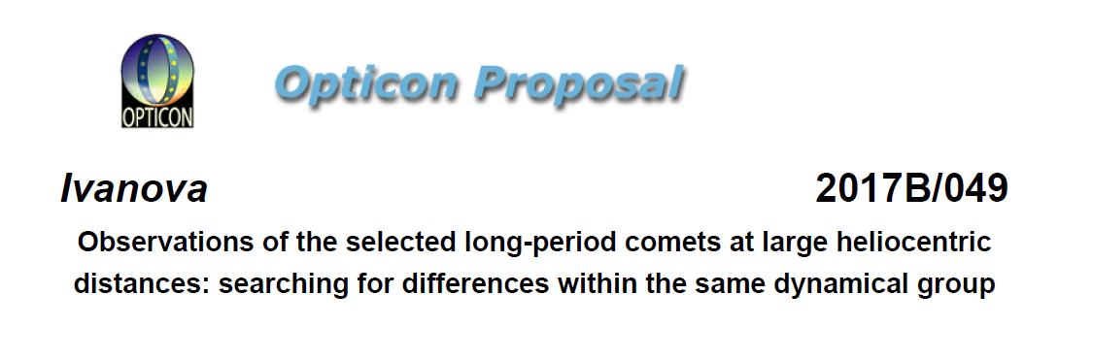
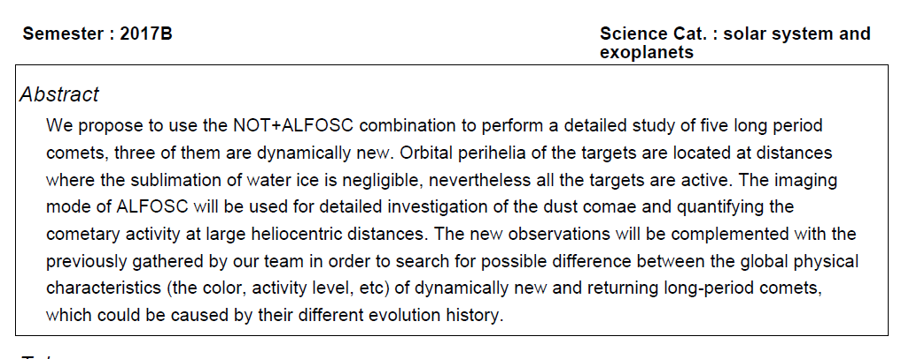

Slide 19
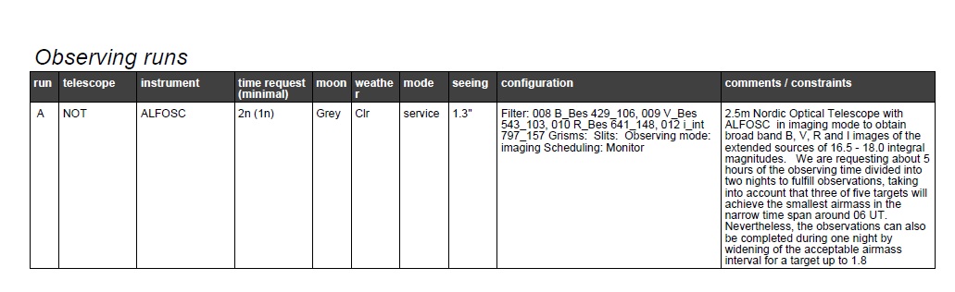
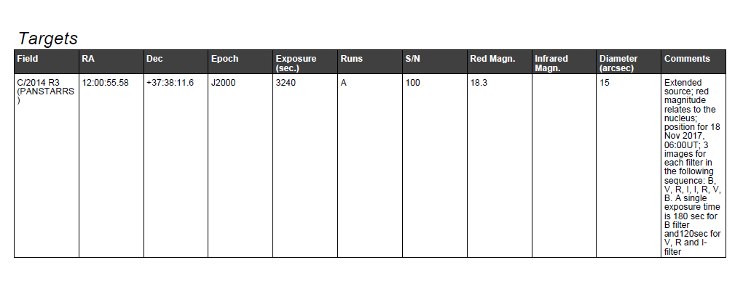

Slide 20
